Slide 1
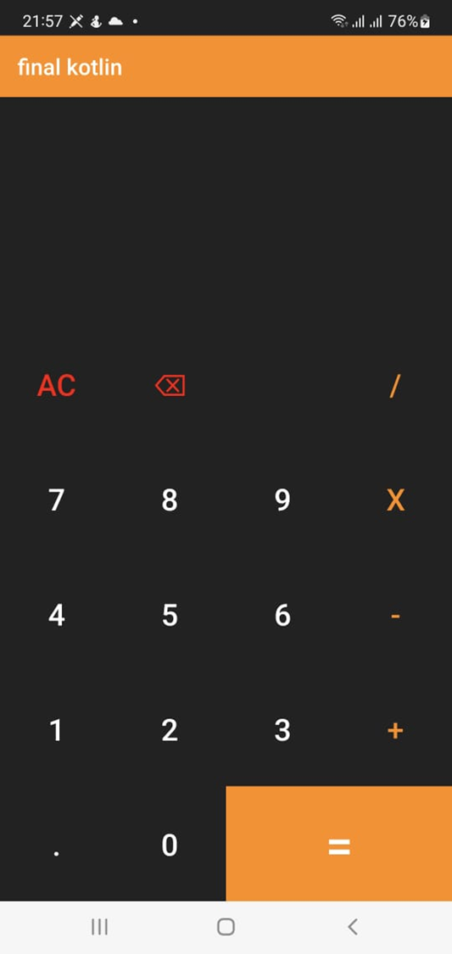
Calculator
A simple calculator using android studio with kotlin programming language.
It does simple operations such as addition, subtraction, multiplication and division.

Slide 2
